Slide 1
YouTube link:
https://youtu.be/viOQ73c95Nc

Slide 2


Conceptual Architecture of Bitcoin Core

Slide 3

Group members
Our Leader: Jinlun Zhang (16jz61@queensu.ca)
2 presenters: Xueyi Jia (18xj8@queensu.ca)
Jihong Zhang (19jz138@queensu.ca)
Other group members:
Yunhan Zhou(17yz101@queensu.ca)
Hejin Wang(15hw45@queensu.ca)
Jing Tao(21jt35@queensu.ca)

Slide 4
Introduction of Bitcoin Core
Bitcoin core is a peer-to-peer electronic payment system which uses a cryptocurrency to transfer value over the internet or act as a store of value like banknote in your wallet.
Bitcoin is a network consisting of many members, called nodes, who follow the Bitcoin protocol and enforce its rules.
Bitcoin Core is simply open source code. This means that anyone is able to view, comment, changes the code.

Slide 5
Derivation Process
Information Collection
Comprehension And Communication
Planning sketch

Slide 6
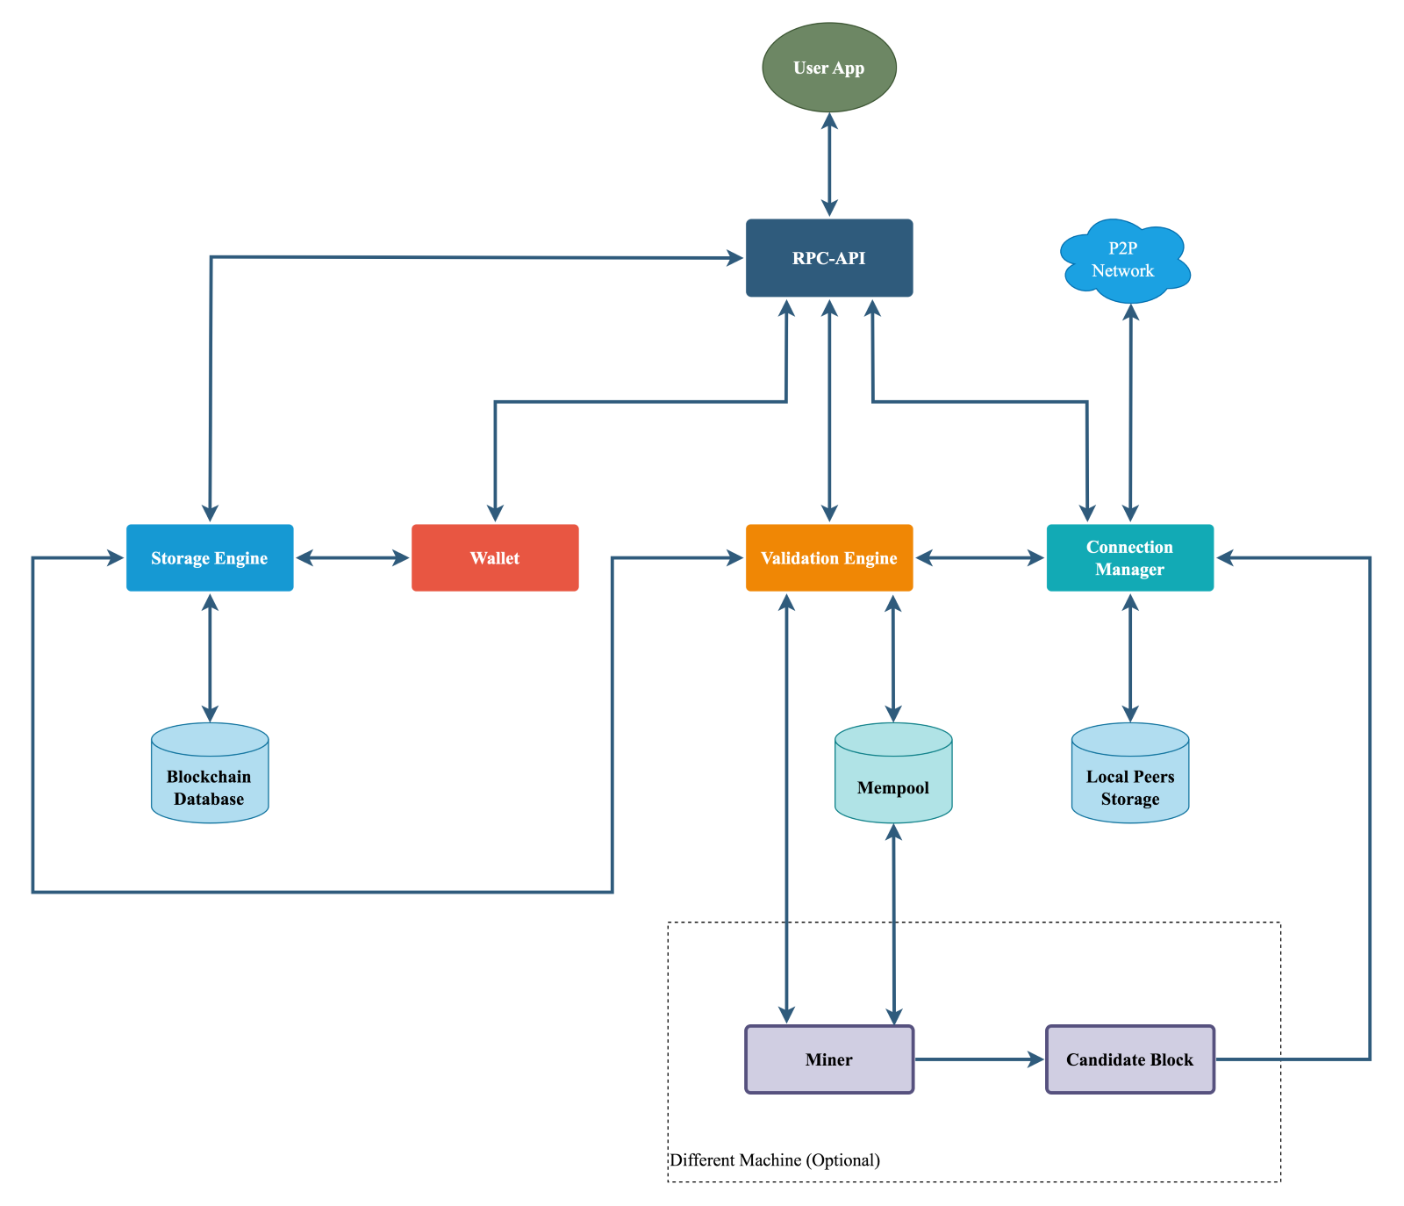
Architecture Style
Client-and-Server architecture style

Slide 7
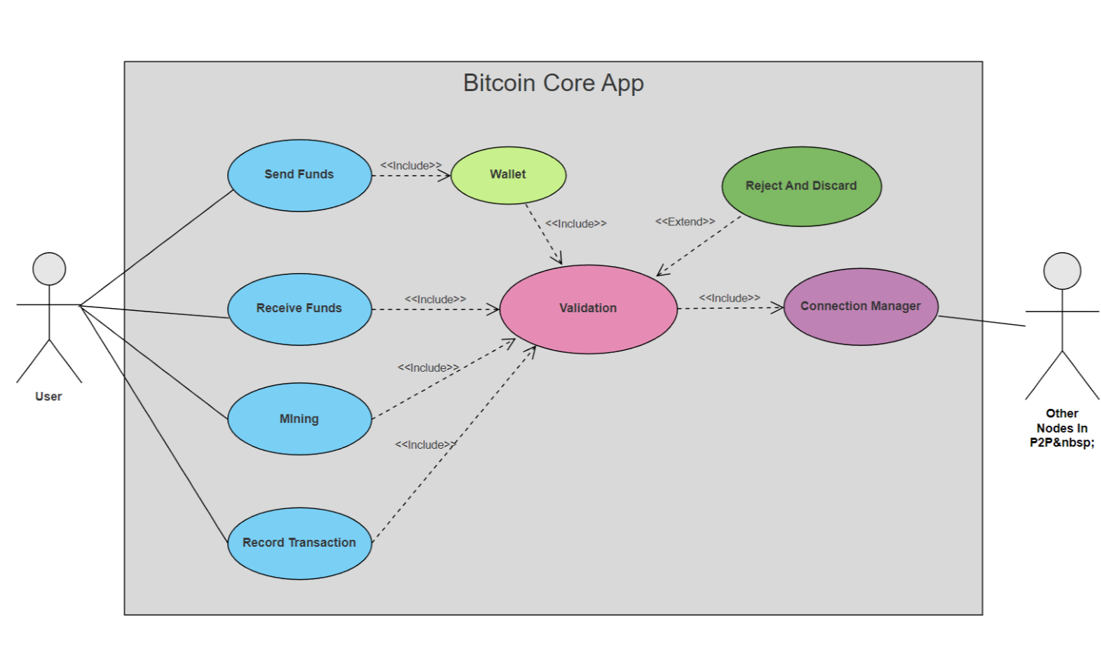
Use case Diagram

Slide 8
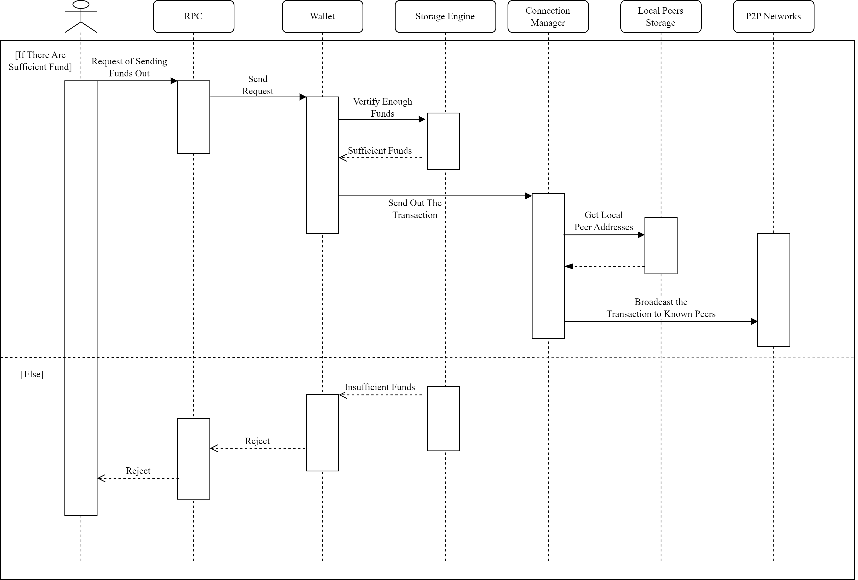
Use case 1 Sending Funds Sequence Diagram

Slide 9
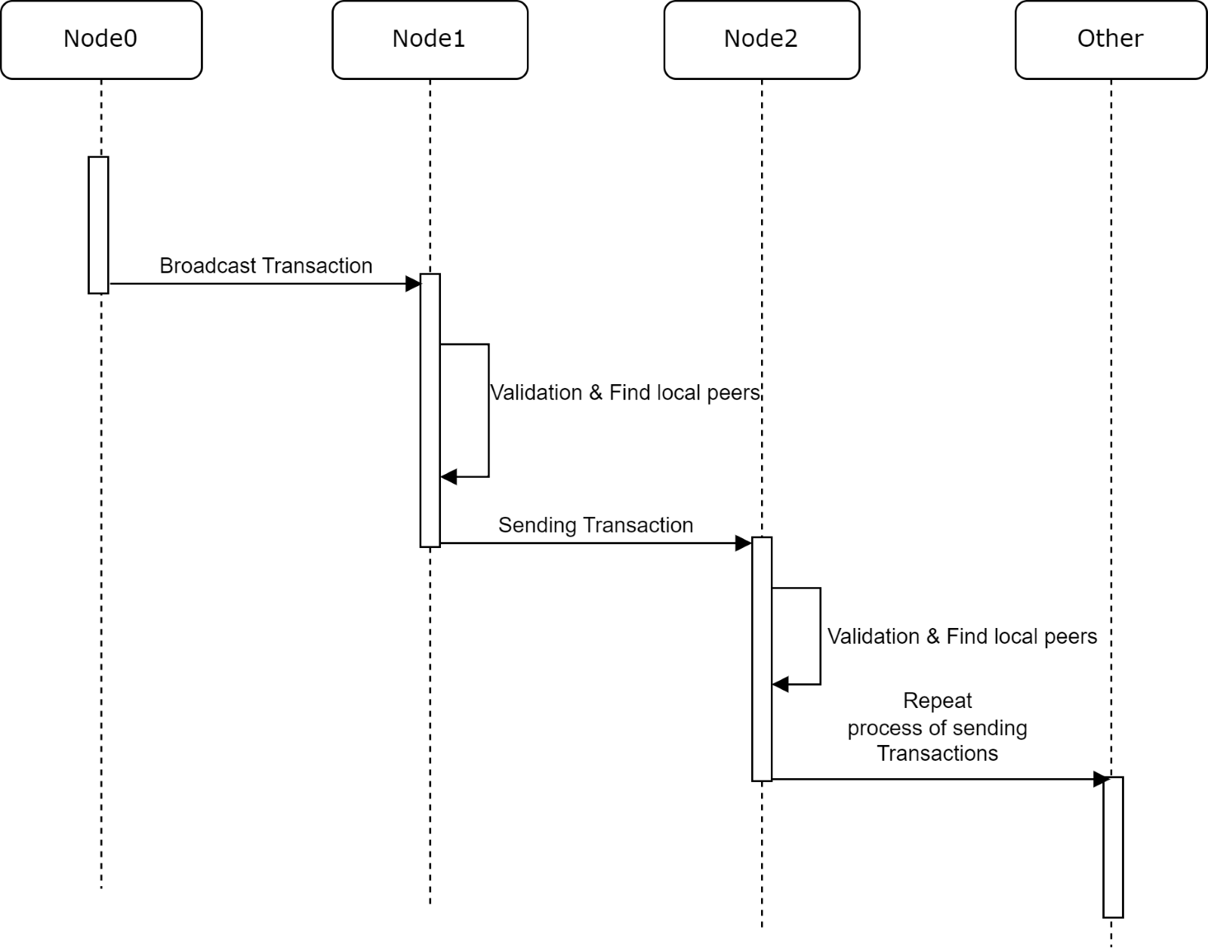
Control and Flow of Data
Decentralized System
P2P Network Architecture

Slide 10
Concurrency
Multithreaded application is chosen by Bitcoin Core as the most suitable model, so that it can perform multiple tasks concurrently, by dividing the workload among multiple threads.
Techniques to solve race conditions and deadlock:
Thread-local storage
Locks
Atomic operations

Slide 11
What we learnt
Learnings on Blockchain
Learnings on Bitcoin P2P Network
Learnings on Teamwork

Slide 12

Conclusion

Slide 13
Thank You

